Slide 1
Effective Software Test Case Design Approach

Slide 2
Overview
Test Case & Test Scenario
Type Of Test Cases
How To Write Effective Test Cases
Best Practices

Slide 3
Test Case
vs
Test Scenario
Contain definite test steps, preconditions, expected results etc..
A complete emphasis on “what to test” and “how to test.”
Multiple Test case can be derived from a single Test Scenario
Time Consuming – For documentation and Execution
Contains high-level documentation which describes an end to end functionality
It focuses on more “what to test” than “how to test”
Test scenarios are derived from test artifacts like user stories, SDD, SRS, etc.
Comparatively less time- For Documentation and Execution

Slide 4
SRS / SDD
Test Scenario 1
Test Scenario 2
Test Case 1
Test Case 3
Test Case 5
Test Case 2
Test Case 4
Test Case 6

Slide 5
Use Of Test Cases In QA Process
Having Test cases
Shared understanding
Save time and effort
Adaptability and faster feedback
Improved Customer satisfaction
Not Having Test cases
Unclear Testing Scope
Incomplete Testing
Increased Defects
Reduced Confidence in Software Quality

Slide 6



Types Of Test Case
Functionality Test Cases
User Interface Test cases
Unit Test Cases
Integration Test Cases
Performance Test Cases
Security Test Cases
Usability Test Cases
Database Test Cases
Compatibility Test Cases
Smoke Test Cases

Slide 7
1) Ensure Testcase Coverage
How To Write Effective Test Cases
How Can We Ensure Test Coverage?
Clear understanding On Requirements
Peer Review
Requirements Traceability Matrix (RTM)
Exploratory Testing
Depend ChatGPT/Search Engines
Proper Order-Helps to Reduce Execution Time
Usability Scenarios
Positive Scenarios
Negative Scenarios
Integration Scenarios
Non-Functional scenarios

Slide 8
2) Follow ISMS standard
How To Write Effective Test Cases
2.1. File Naming
Unit Testcase --> {Project Name}-ISL-ISMS-50-Unit Test Case & Result.xlsx
Module Testcase --> {Project Name}-ISL-ISMS-50-Test Case & Result.xlsx
Review Testcase --> {Project Name}-ISL-ISMS-53-Review.xlsx
2.2. Use of correct font and font size
2.3. Use of correct Test Case Template

Slide 9
3) Make Your Test Cases Clear And Easy To Understand
How To Write Effective Test Cases
3.1. Short and clear Description in simple English
3.2. Proper use of Feature and Sub-Feature
2.3. Specify Proper Expected Results
Example: Expected result for Success login TC
1) The user should authenticate and redirect to home page.
2) The user's profile information should be relevant in the home page
3) Notification message should be displayed in the home page
Feature | Sub-Feature
User Management | Page Redirection
User Management | User Registration
User Management | Validation of 'Name" field
User Registration | Verification of Response Time

Slide 10
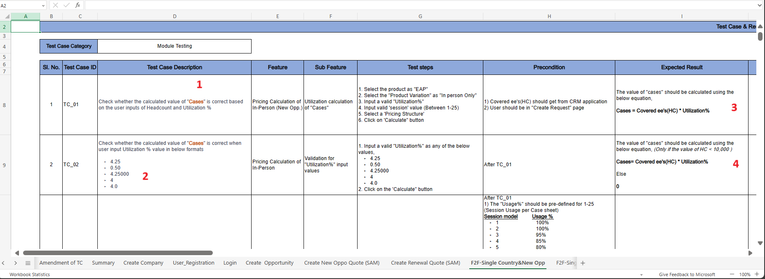
1) Use “Bold” “Italics” “bullet points “colors” for important Text/contents
Best Practices

Slide 11
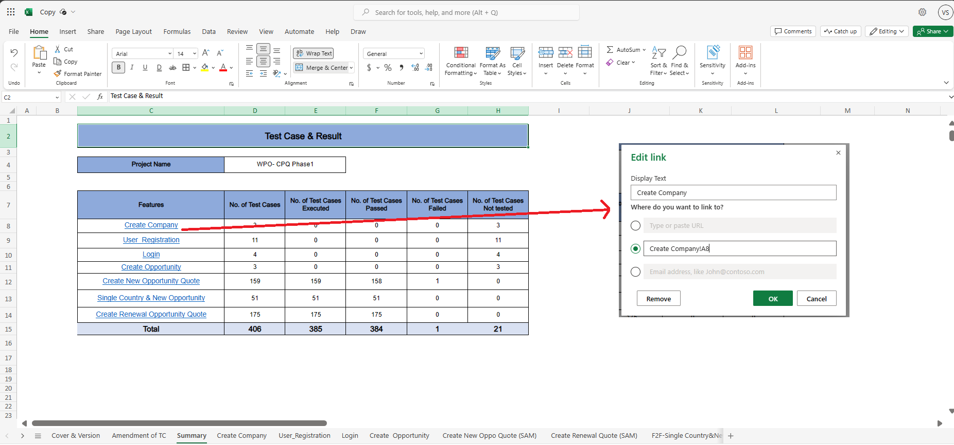
2) Summary sheet link & Equations
Best Practices

Slide 12
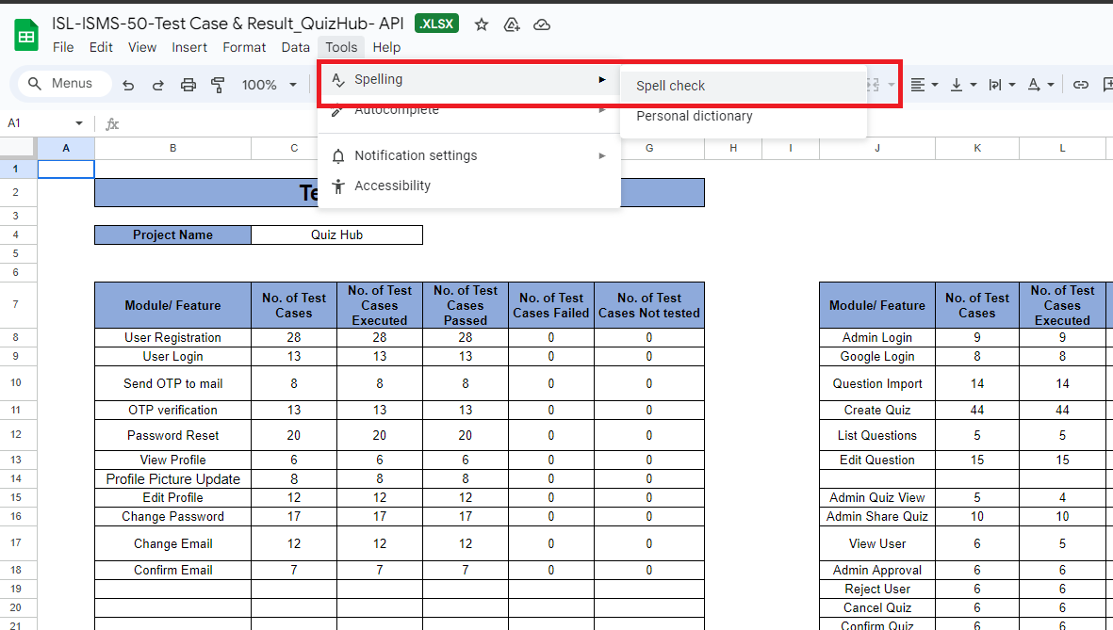

3) Do Spell Check & Grammar Check
Best Practices

Slide 13
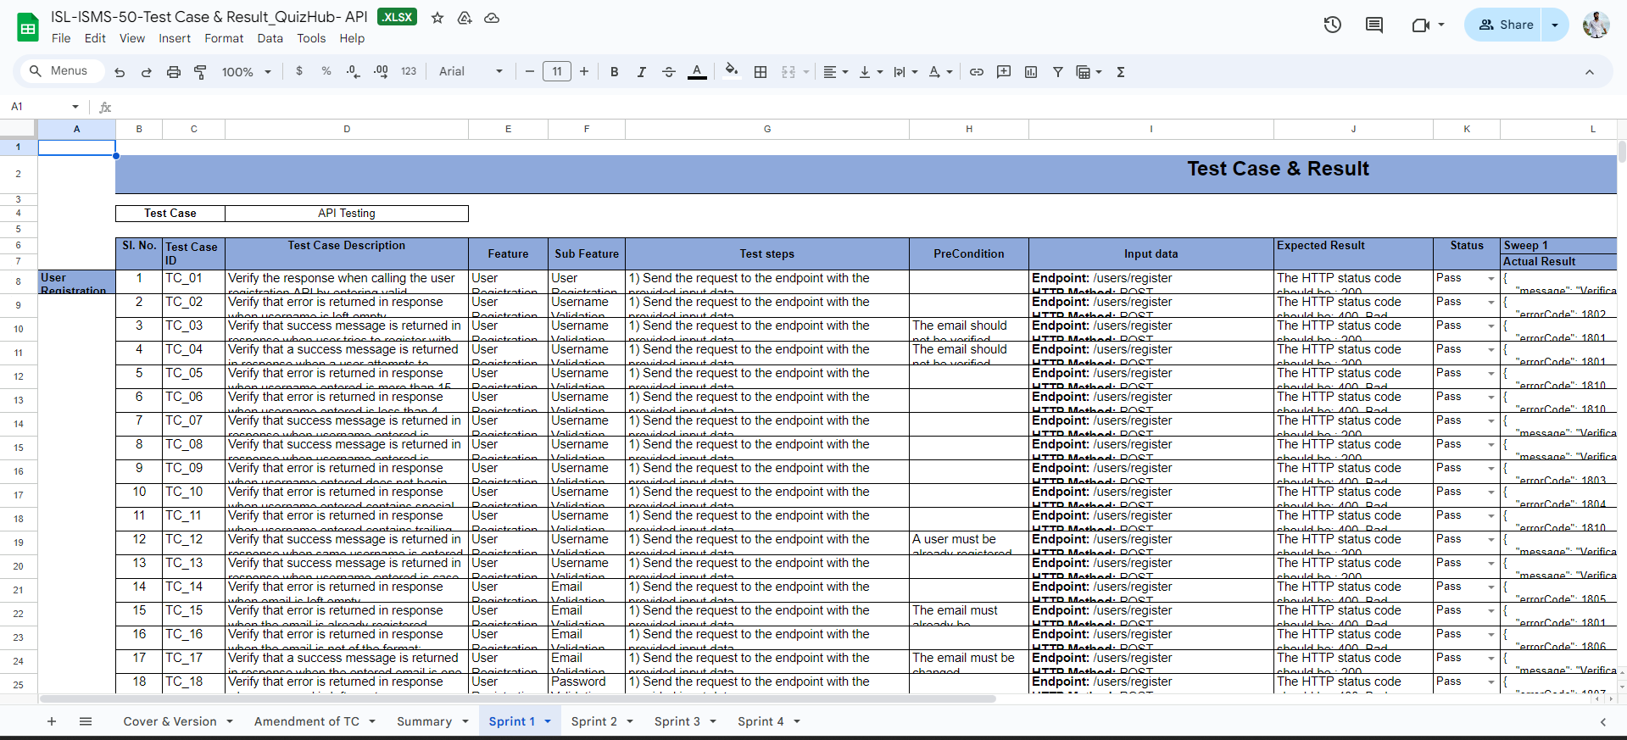
4) Test Case Formatting ( "Height" and "Width“)
Best Practices

Slide 14
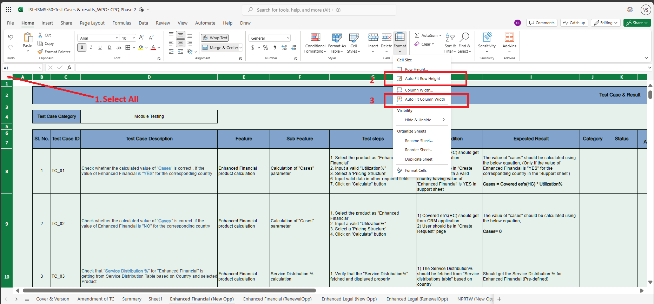
Best Practices

Slide 15
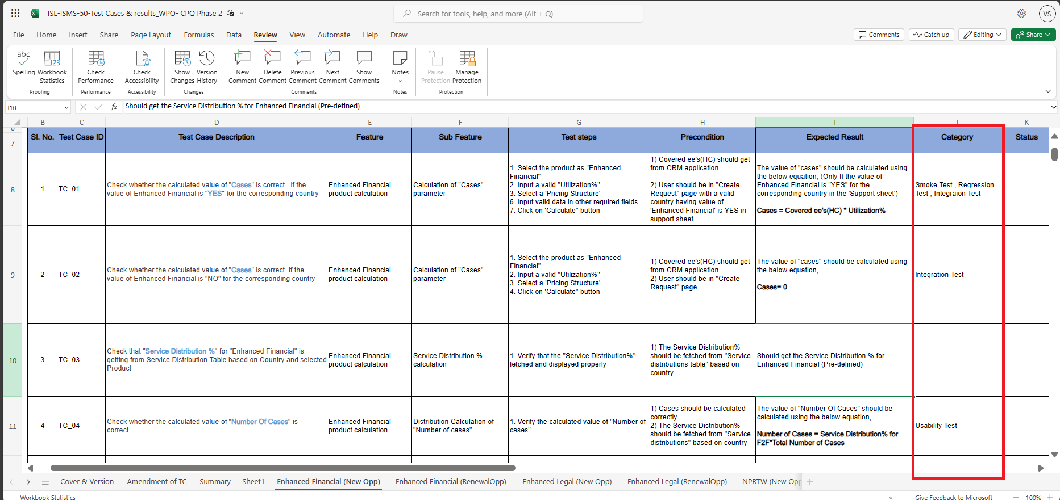
5) Mapping of "Testcase Type" in category column
Best Practices

Slide 16
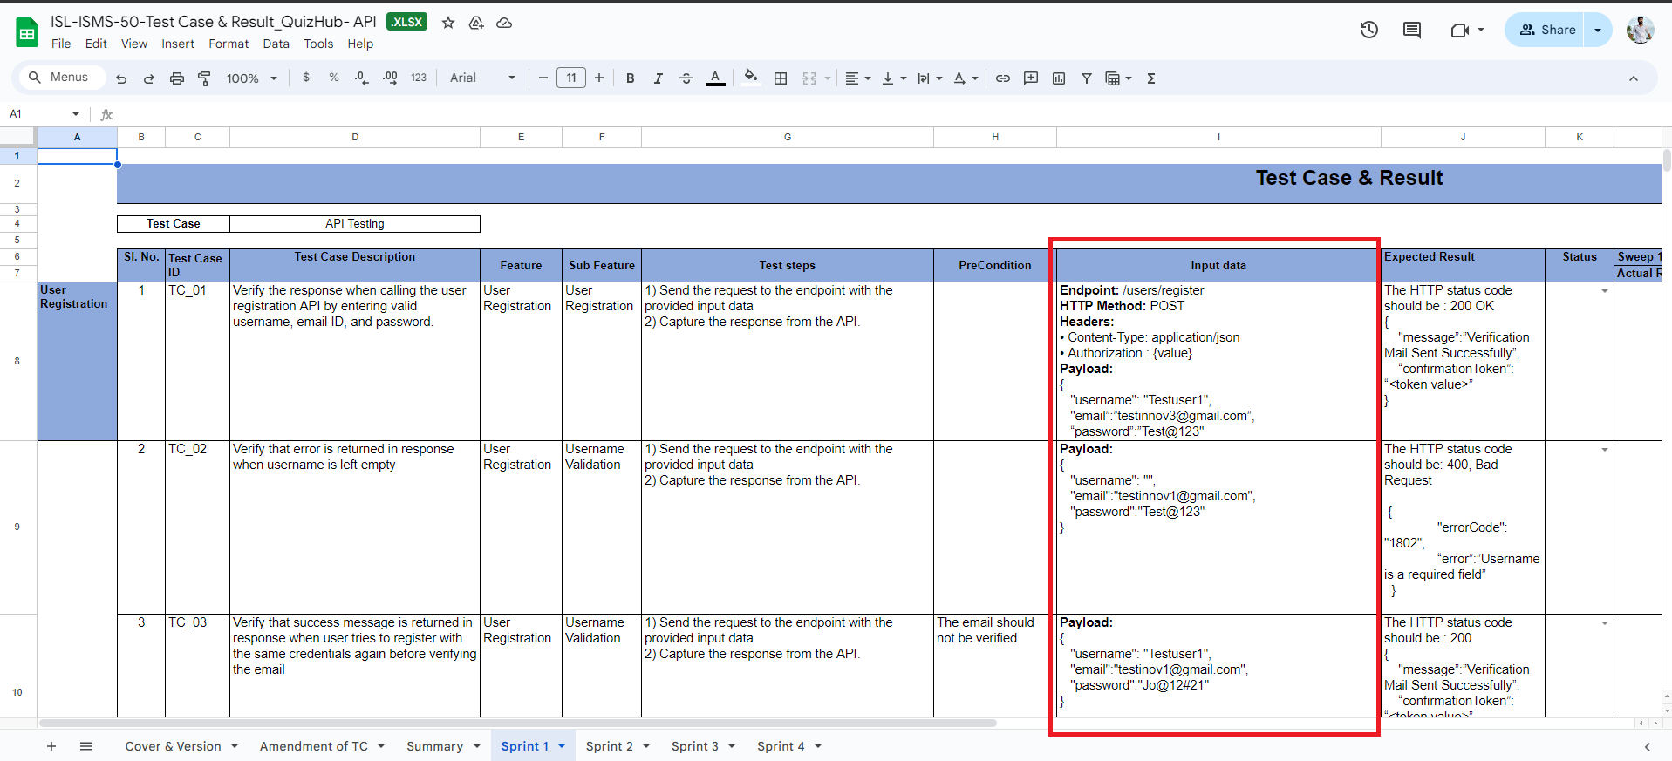
6) Adding input data- Especially for API testcases
Best Practices

Slide 17
Thank you!

